Slide 1
A python module can be defined as a python program file which contains a python code including python functions, class, or variables.
In other words, we can say that our python code file saved with the extension (.py) is treated as the module. We may have a runnable code inside the python module.
Modules in Python provides us the flexibility to organize the code in a logical way.
To use the functionality of one module into another, we must have to import the specific module.

Slide 2

Example
In this example, we will create a module named as file.py which contains a function func that contains a code to print some message on the console.
Let's create the module named as first.py.
we need to include this module into our main module to call the method displayMsg() defined in the module named first

Slide 3
Loading the module in our python code
We need to load the module in our python code to use its functionality. Python provides two types of statements as defined below.
The import statement
The from-import statement
The import statement
The import statement is used to import all the functionality of one module into another.
Here, we must notice that we can use the functionality of any python source file by importing that file as the module into another python source file.
We can import multiple modules with a single import statement,

Slide 4

Hence, if we need to call the function displayMsg() defined in the file first.py, we have to import that firstas a module into our module .
import first;
name = input("Enter the name?")
first.displayMsg(name)

Slide 5
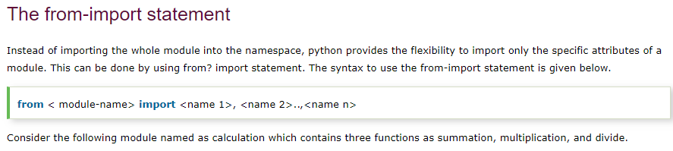

Slide 6
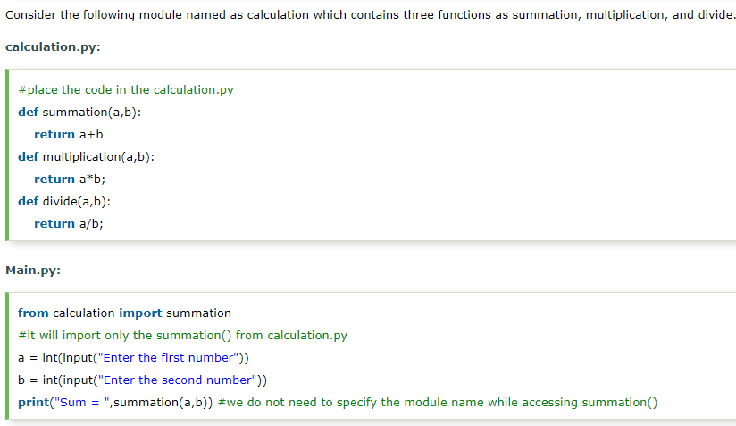

Slide 7
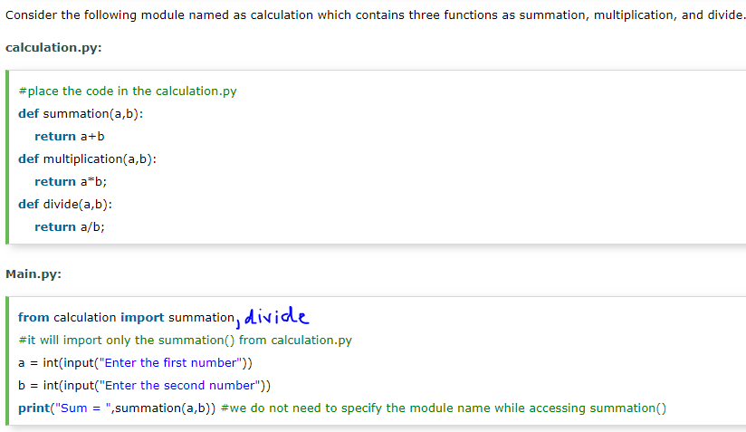

Slide 8
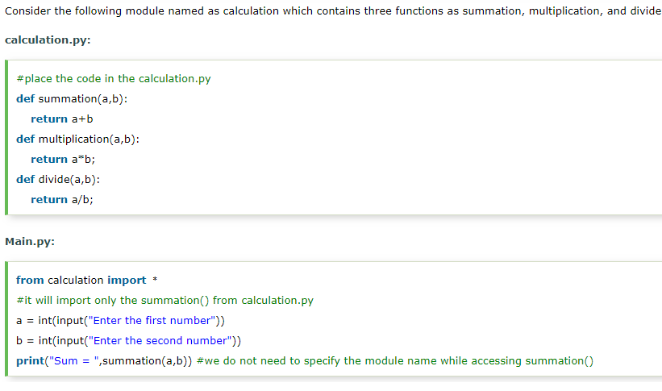

Slide 9
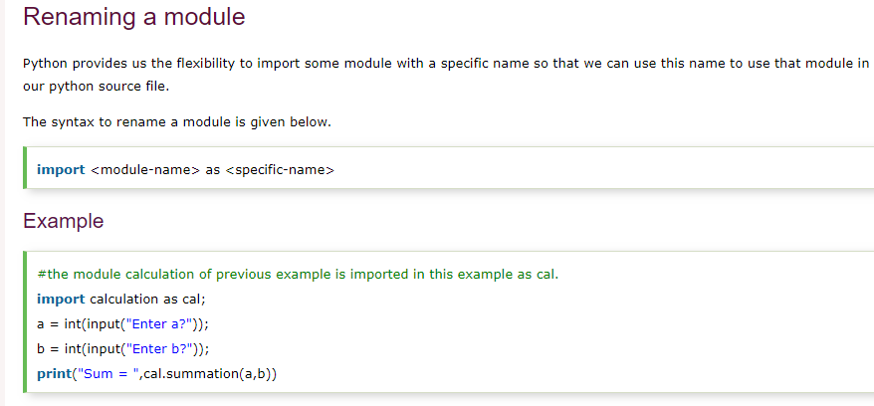

Slide 10
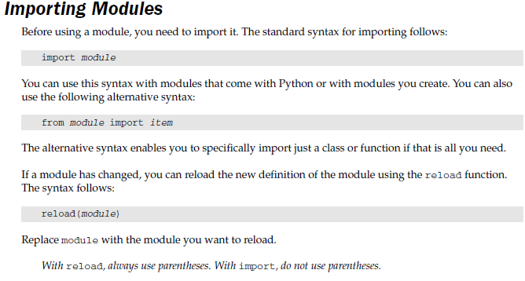

Slide 11
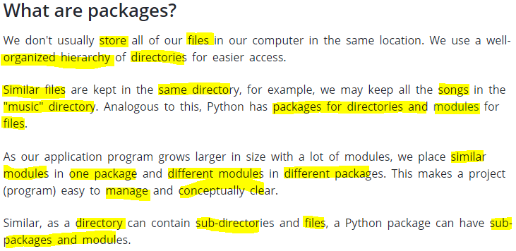
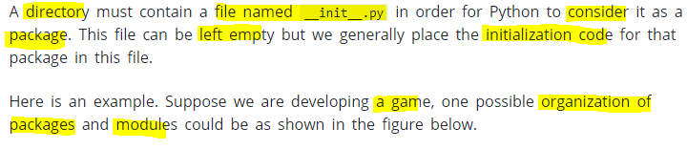

Slide 12
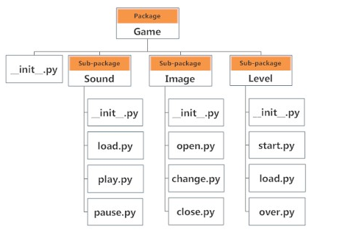
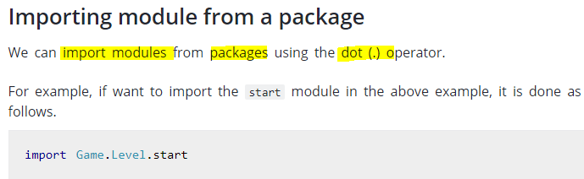

Slide 13
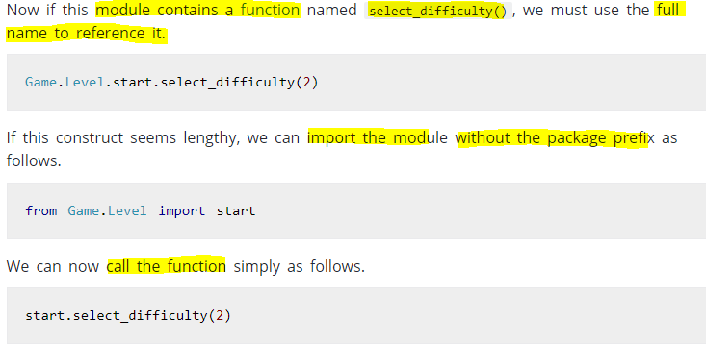

Slide 14
